Slide 1





Sky Harvest Industries
STRATEGIC SUPPLIER AND COST ANALYSIS
By Shreya Mishra

Slide 2


INTRODUCTION
The dataset provides a comprehensive overview of the
company’s procurement activities.
•Focuses on identifying:
Where money is being spent?
Which suppliers are most utilized?
Which commodities are driving costs?
•It serves as an essential tool for:
Cost optimization.
Supplier management.
Future procurement planning.
•Insights derived from the data will help guide:
Supplier negotiations.
Resource allocation.
•Efficiency improvements in the procurement process.

Slide 3


Sky Harvest Industries
Objective
The company's primary objective is to manage and optimize its procurement process to ensure cost efficiency, maintain strong relationships with suppliers, and support operational needs. By effectively managing procurement activities, the company aims to reduce costs, streamline operations, and ensure a reliable supply of goods and services to meet business demands.
Business Problem
The company is facing challenges in managing its procurement activities due to a lack of visibility into key metrics such as supplier performance, cost distribution across departments, and commodity-based expenditure. This has resulted in rising procurement costs, uneven supplier utilization, and potential inefficiencies in resource allocation.

Slide 4
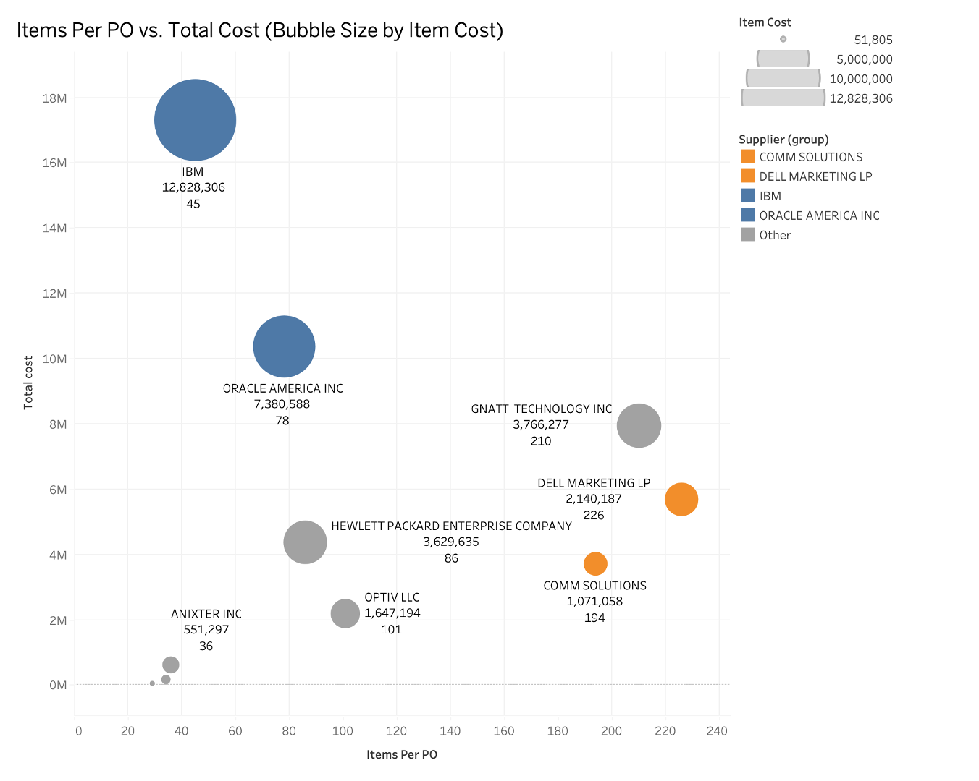
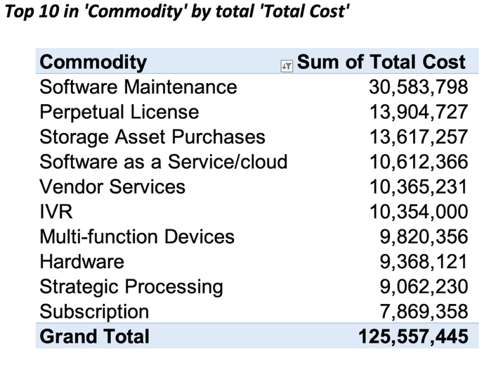
Strategic Supplier and Cost Analysis for Enhanced Procurement Efficiency
Supplier Insight: Pinpoints key suppliers and major cost drivers.
Cost Optimization: Aids in strategic financial planning and cost reduction.
Efficiency Improvement: Enhances negotiation leverage and resource management.

Slide 5
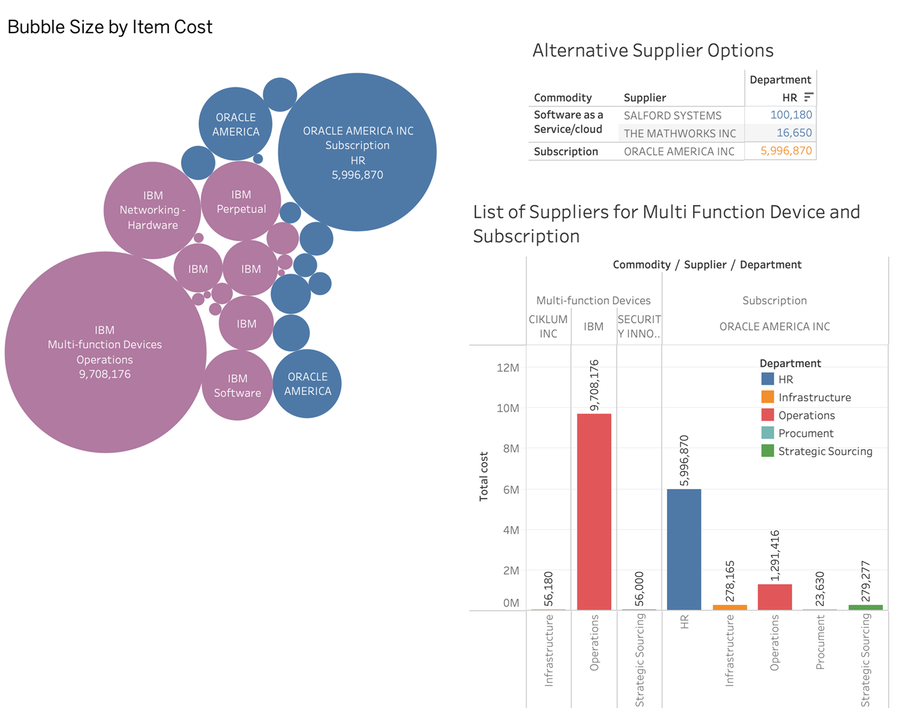
Comprehensive Commodity Spend Analysis and Supplier Diversification Strategy
Commodity Spending: Analyzes costs by item and supplier options.
Supplier Options: Compares alternatives for better procurement strategies.
Decision Support: Aids in strategic sourcing and budget allocation.

Slide 6
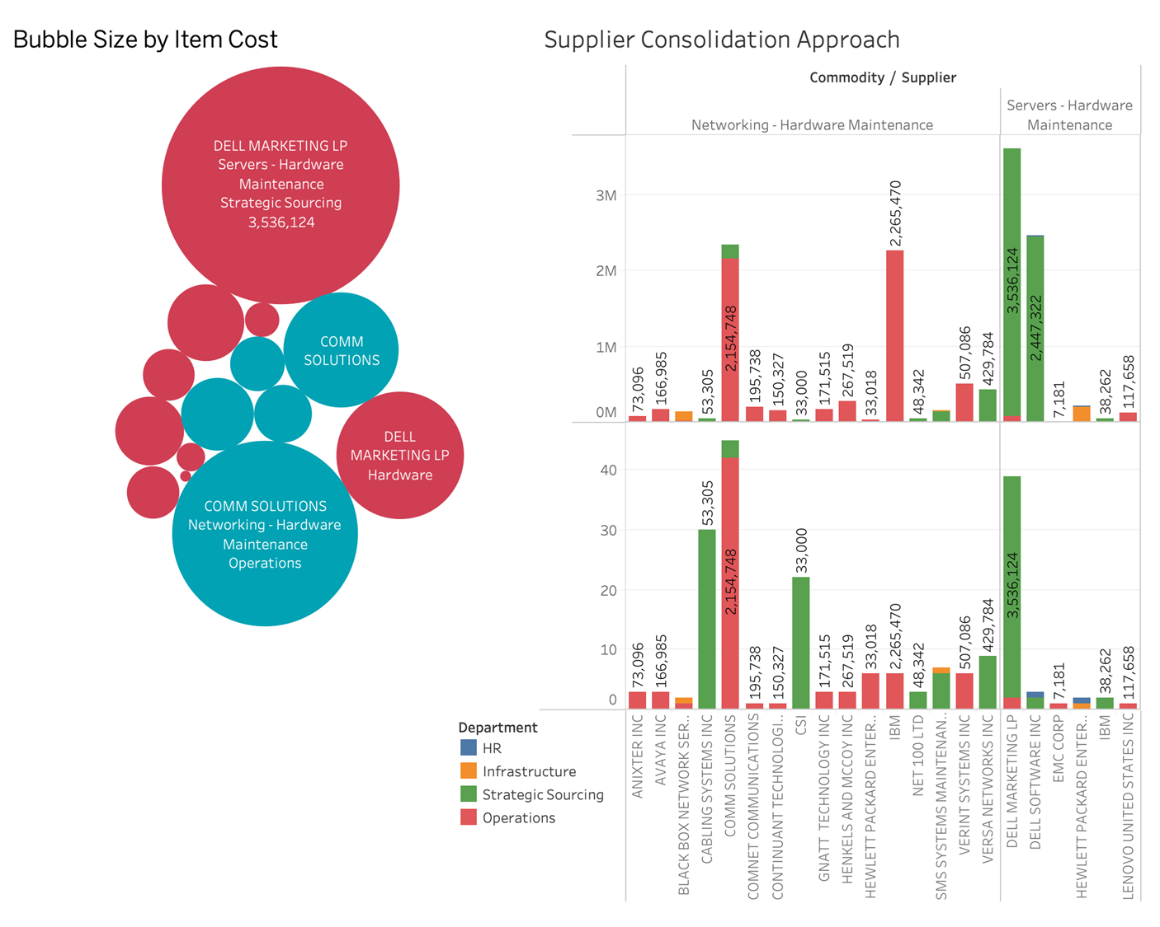
Optimizing Spend and Supplier Management in Hardware Maintenance
Expenditure Analysis: Visualizes hardware maintenance spending and supplier consolidation opportunities.
Supplier Evaluation: Assesses supplier performance and integration potential.
Operational Efficiency: Supports strategic management to optimize costs and enhance efficiency.

Slide 7
STRATEGIC PLAN & RECOMMENDATIONS
Dell Marketing LP and Comm
Consolidate Suppliers for Networking and Hardware Maintenance
Negotiate Better Terms with High-Spend Suppliers - Multi Function Device
IBM, Oracle America, and Dell Marketing LP.
Introduce alternatives to IBM and Oracle America for software and cloud services
Increase Supplier Diversification in Strategic Sourcing and IT Infrastructure

Slide 8

THANK YOU

